Slide 1
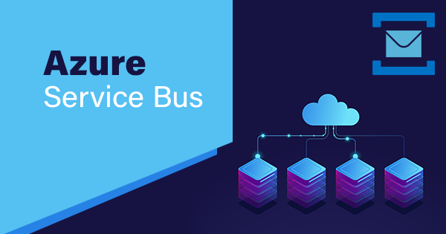

Slide 2
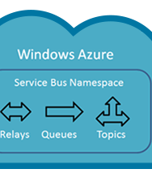
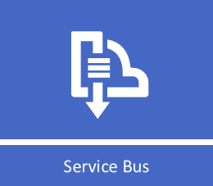
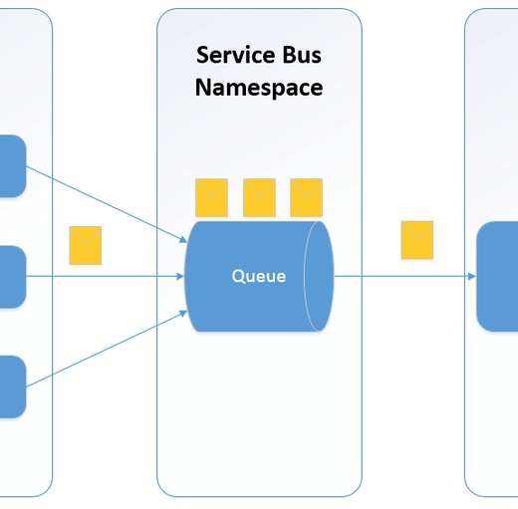
Topics
1.What is Service Bus?
2.Architecture.
3.Why Service Bus?
4.Features.
5.Services.

Slide 3
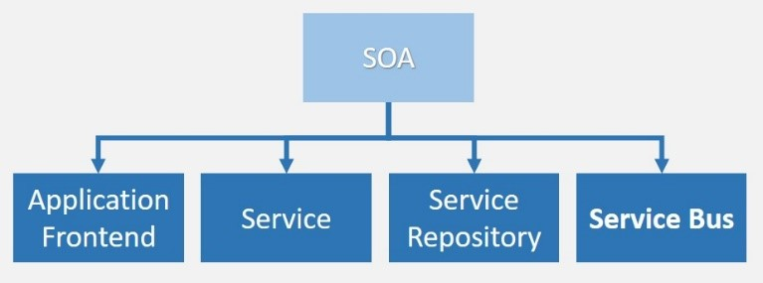
Service Bus..
Software applications have different components like front-end app, backend web services, schedulers etc. SOA (software-oriented architecture) proposes a design for software implementations where these components can communicate with each other by application components through communication protocol over a network. These application components can be visualized as Service Bus.
Azure Service Bus is a fully managed multi-tenant cloud messaging service (MAAS).
Applications and services can communicate with each other using messages via Service Bus.
Message consists of two parts; message properties and message payload. Message properties is a dictionary of values against property keys. Message payload is in binary format, which can contain JSON, XML, or text data.

Slide 4
Some Common Messaging Scenarios:
Messaging : Transfer Business Data.
Decouple Applications : Improve reliability and scalability of applications and services.
Load Balancing : Allow multiple consumers to read from a queue at the same time.
Topics and Subscriptions : Enable 1:n relationships between publishers and subscribers.
Transactions : Allow you to do several operations in atomic transaction.
Message sessions : Implement high scale coordination of workflows ad multiplexed transfers
that require strict message ordering or message deferral.

Slide 5
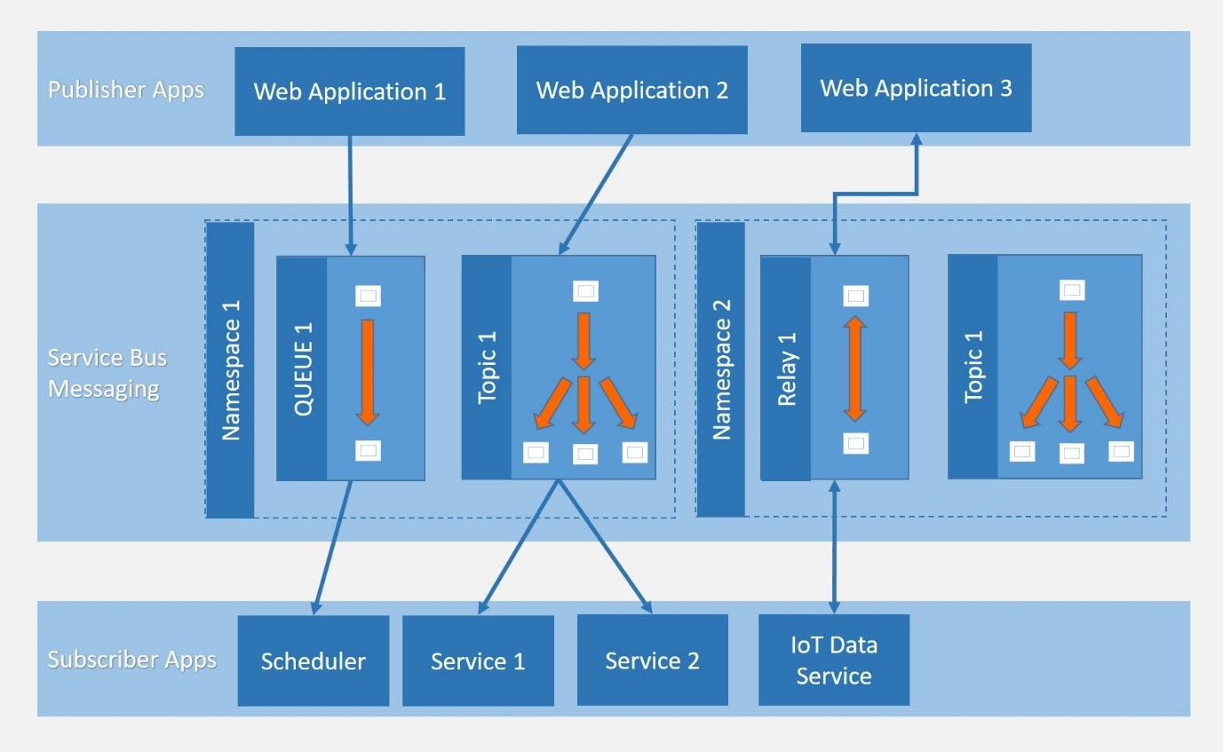
Architecture..

Slide 6
Azure Service Bus offers three types of communication mechanisms; queues, topics and, relays.
Queues and Topics, facilitate one-directional communication.
Messages will be stored until they are consumed.
Each message in Queue is received by a single recipient.
Topic can have multiple subscriptions for multiple receivers.
Subscriptions can choose to receive messages based on parameters.
Messages from Queues and Topics can be accessed using Service bus-defined messaging APIs or REST APIs.
Unlike Queues and Topics; Relays provide bi-directional communication and does not store messages.
To use these messaging services, user must create namespace under Azure subscription.
A namespace can be visualized as a logical container for messaging components.
Multiple Service Bus components (queues, topics and relays) can reside within a single namespace.

Slide 7
Why Service Bus??
As Azure Service Bus is fully managed service, scaling and availability will be taken care by Azure team.
It is integrated with other Azure services like, Event Grid, Logic Apps, Stream Analytics etc.
Azure Service Bus provides reliable and secure asynchronous message communication platform along with facility of delayed processing of events or data.
Shared Access Signatures (SAS), Role Based Access Control (RBAC) and Managed Service Identity (MSI) protocols are supported by it.
Service Bus also supports client libraries for .Net , Java.

Slide 8
Service Bus Tiers With Features..
Standard Tier
Premium Tier
It can be used for initial development and QA environment deployments.
Latency and throughput in Standard tier are variable, hence performance is not predictable.
In built scaling is also not available and maximum message size is up to 256 kb.
It can be used for Production deployments. It provides high throughput and auto scaling for variable workloads.
Maximum message size can be up to 1mb. Premium name spaces provides CPU and memory level isolation for resources.
Performance of Premium tier resources at peak load is much faster than Standard ones.
Notes:
(These don’t have designer IDs since they were based off the default master slides already in the deck.

Slide 9
Service Bus Services…
Queues
Topics
Relays
Queues messaging service offers First In First Out data delivery.
It enables ordered handling of unbounded sequences of related messages.
Messages in queues are timestamped on arrival and ordered according to it.
Topics is nothing but single input queue but multiple output queues.
Output queues are nothing but Subscriptions.
Receiving apps needs to create subscriptions to receive messages from Topic.
To facilitate bi-directional communication, Azure provides Relay messaging service.
Idea of providing Relay method is to connect applications irrespective of their deployment environment.

Slide 10
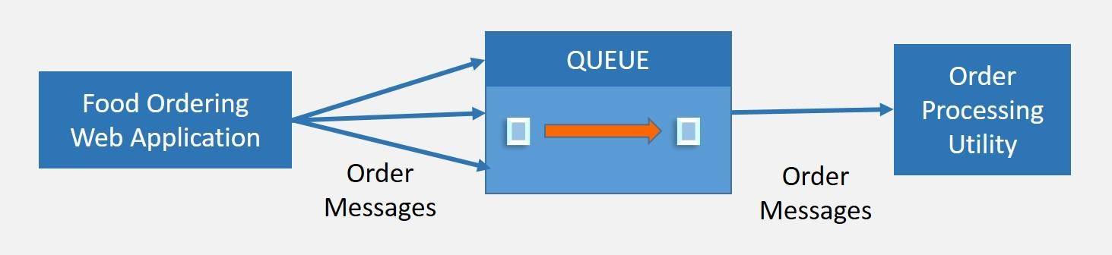
Queues
Lets take an example, where people are ordering food from online website application. When user done with ordering, message with order menu will be pushed into Queue by application. Order processing application will consume messages from Queue and process it one by one for delivery. Here food order must be processed in sequence. Hence, Queue is perfect option to choose.

Slide 11
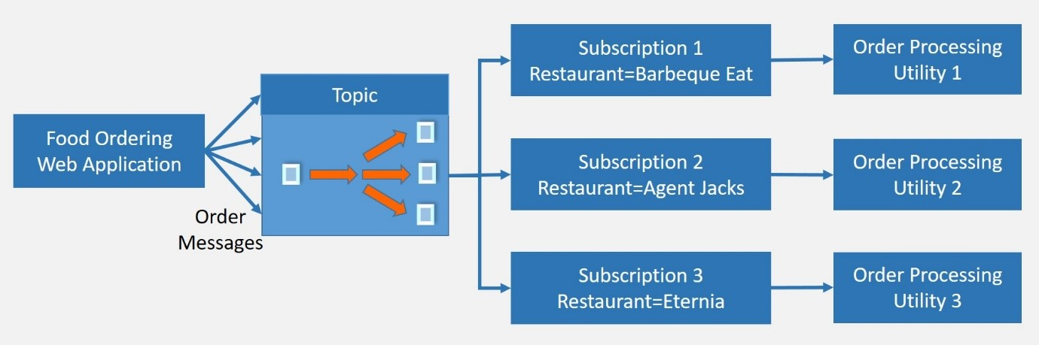
Topics
Let us use same example, which we have discussed above. Now we require high throughput while processing incoming orders. Here we can add multiple order processing applications, which will be reading same message queue. It is not possible to have multiple receivers for a Queue. Hence, we will create different subscriptions based on restaurant selected in order and process them differently. Subscription will filter the messages from Topic by restaurant name. Each order processing application will read message from respective subscription.

Slide 12
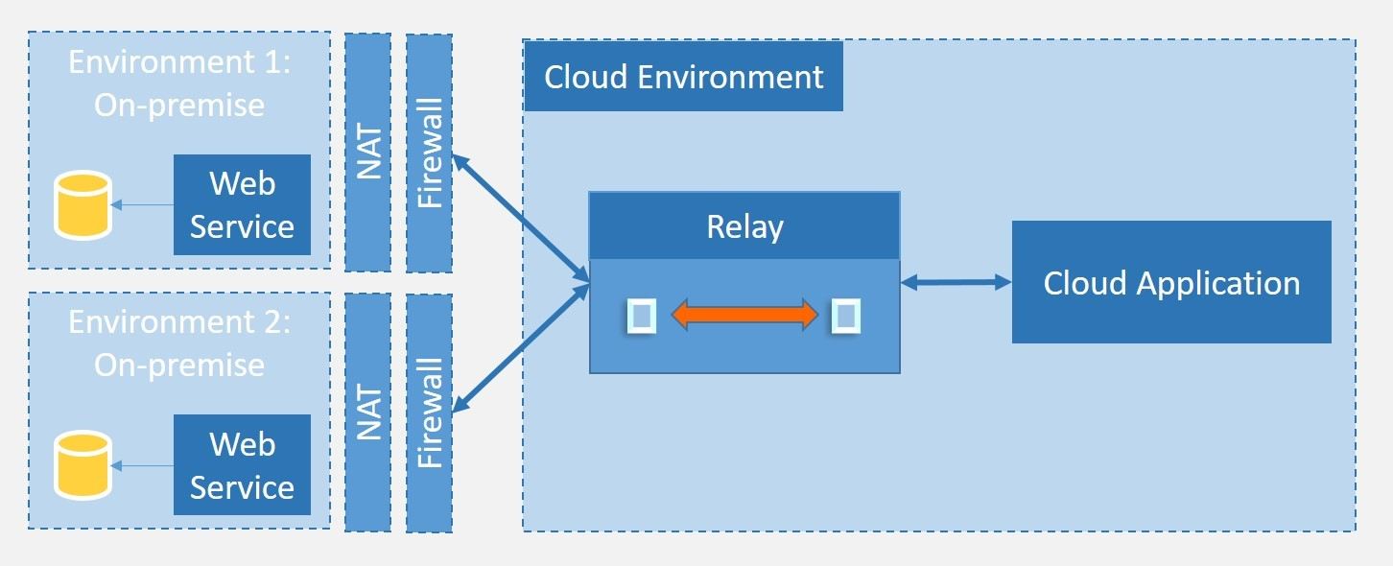
Relays
We do not need to create relays explicitly. Relay will be created when application established connection to Service Bus. Idea of providing Relay method is to connect applications irrespective of their deployment environment. Some of the applications are deployed to different on premise data centers. To connect these applications for communication is not trivial task of development as well as configuration. To provide direct communication between applications without much effort, we can go for Azure Service Bus Relays.

Slide 13
Thank you
Keerthi Reddy

